Slide 1
Species and trophic dynamics
October 22, 2019

Slide 2
Why do we care about anything other than plants and microbes?
Dominate energy (>95%) and nutrient transfer in terrestrial ecosystems
NPP uncertainty is greater than energy transfer from plants to animals

Slide 3
What is the purpose of a food web?

Slide 4
Who controls these interactions?

Slide 5
Bottom up controls

Slide 6
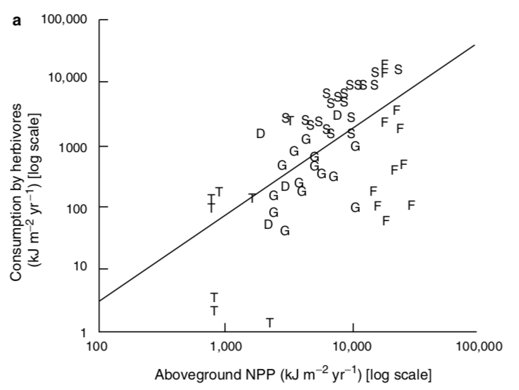
Herbivory increases with NPP

Slide 7
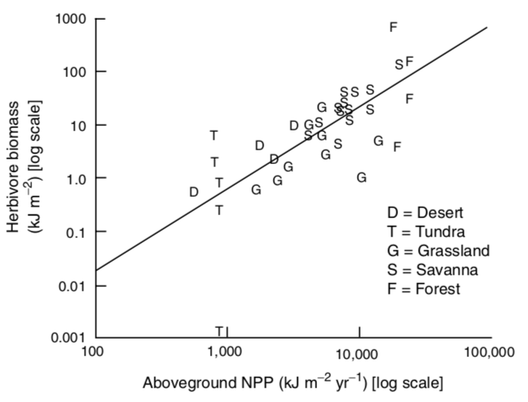
Herbivore biomass increases with NPP

Slide 8
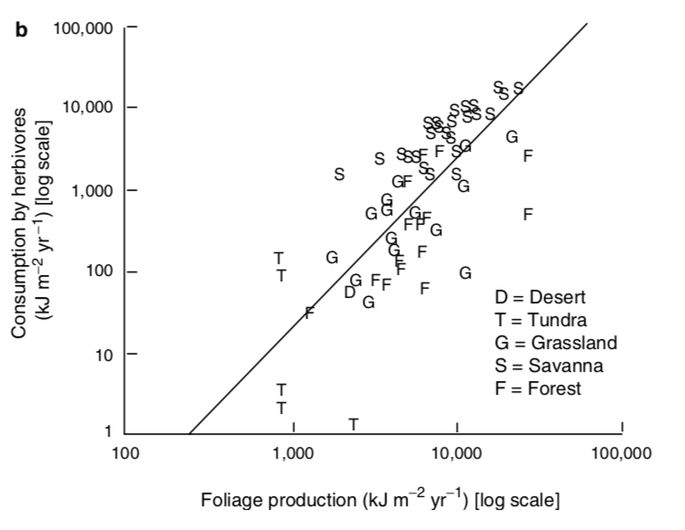
Actually driven by leaf production
Why?

Slide 9
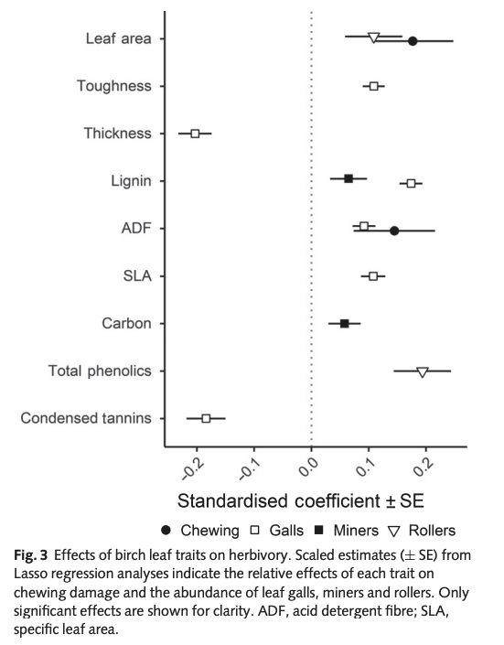
Leaf traits influence herbivory
Muiruri et al. (2019) New Phytologist

Slide 10
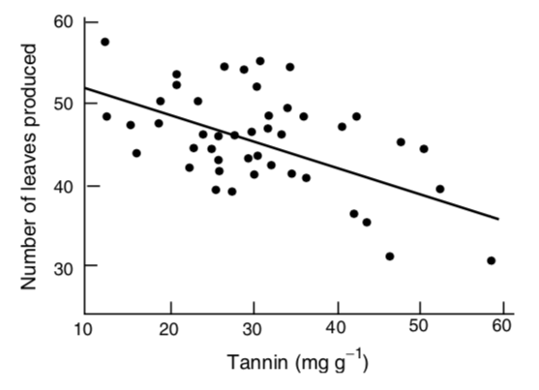
But there is a trade-off

Slide 11
But there is a trade-off
So maybe plants aren’t fully driving these interactions!

Slide 12
Top down controls

Slide 13
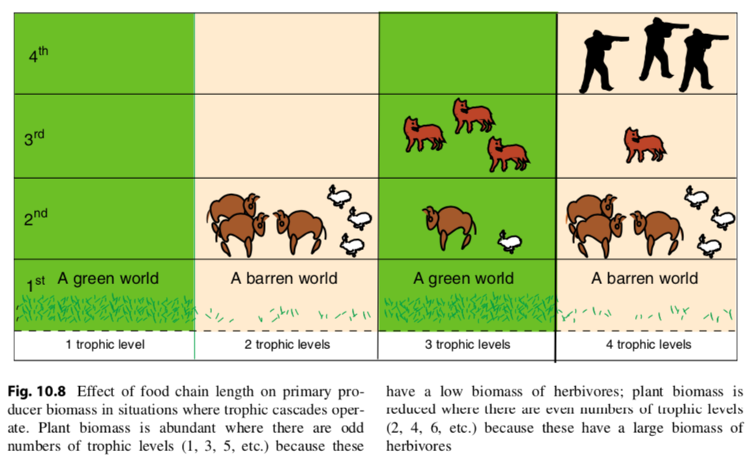

Slide 14
What types of organisms exert the strongest top-down controls?

Slide 15
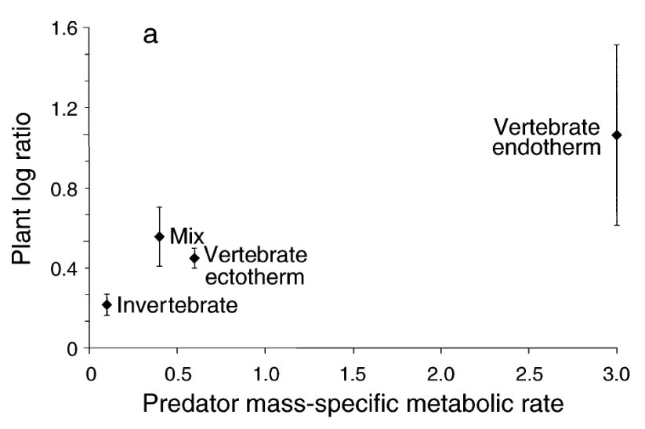
Top-down control strength
Borer et al. (2005)

Slide 16
Energy flow through trophic levels

Slide 17
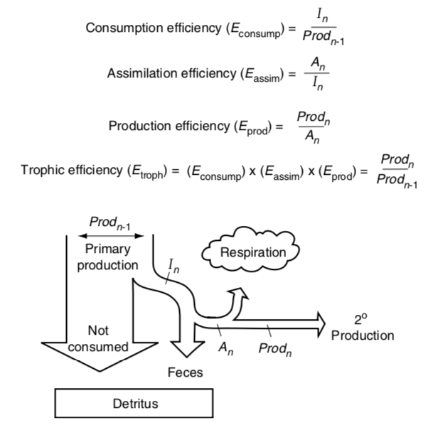

Slide 19
Percent on production by lower trophic level that is consumed by the higher trophic level

Slide 20
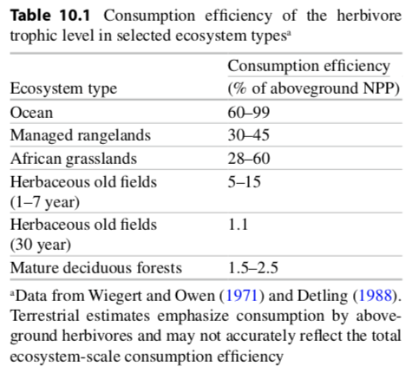

Slide 21
The amount consumed that is assimilated into the organism (not pooped out)

Slide 22
Carnivores have 4x greater assimilation efficiencies than herbivores. Why?

Slide 23
The amount assimilated that is not respired

Slide 24
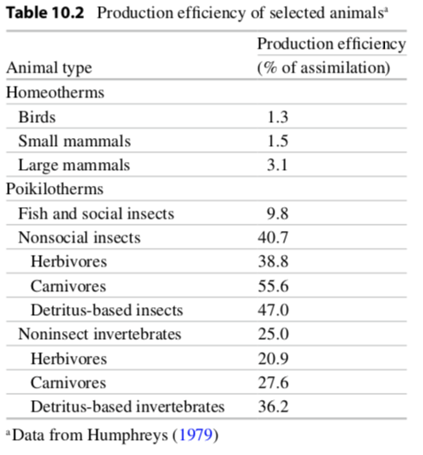

Slide 25
Efficiency of the trophic level

Slide 26
Activity: what is the largest food chain you can create?
Notes:
To determine what controls food chain length

Slide 27
How does nutrient and energy flow differ?

Slide 28
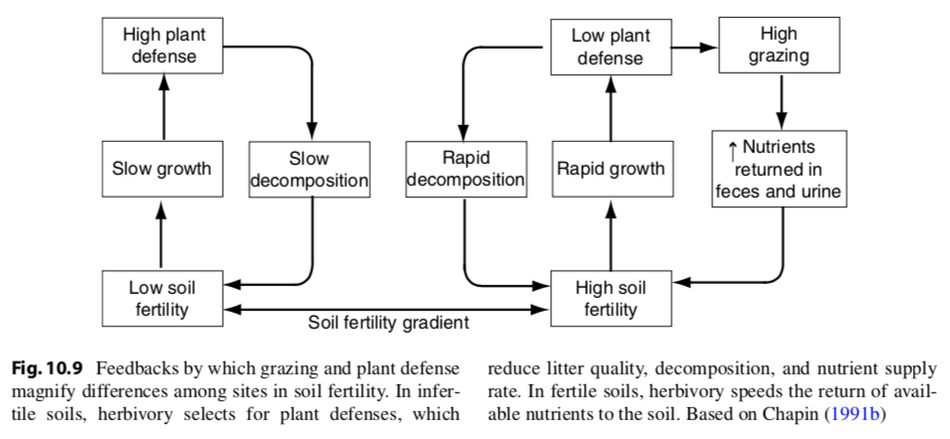
Herbivores speed nutrient flow

Slide 29
Species-level impacts

